Slide 1
Meeting with the monitoring committee 3rd year
University of Bordeaux
Doctoral School of
Mathematics and Computer sciences
Talence, 20 June 2019
Notes:
1

Slide 2
Subject
Supervisor: Marie BEURTON-AIMAR
“Automatic landmarking for 2D biological pictures:
image processing with and without
deep learning methods”
Notes:
2
This subject belongs to a collaboration project with the biologist at INRA Rennes to evaluate the effects between environments and evolution of the insects.

Slide 3
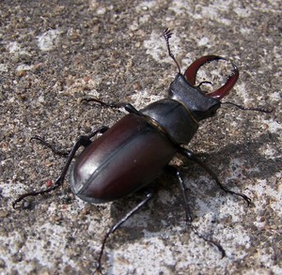
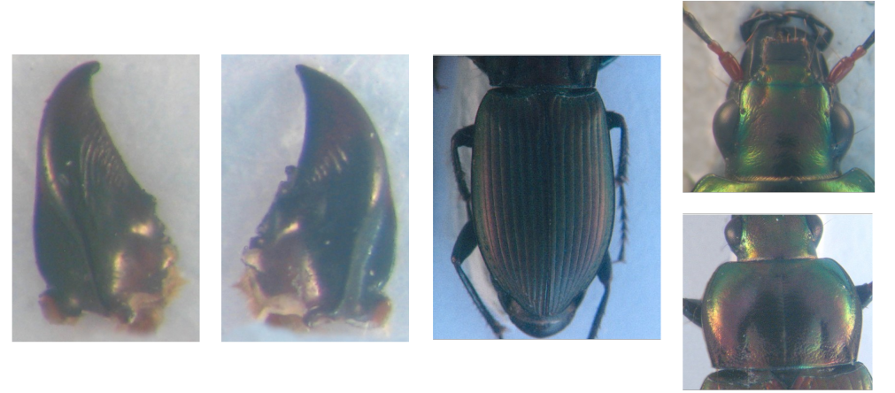
Dataset
Color images (2D) of 293 beetles (3264 x 2448)
Five images by insect: head, pronotum, elytra, left and right mandible
Notes:
3
In order to do that, a set of 293 beetles have been collected.
Then, five images correspond to 5 parts of beetle have been taken into account.
They are including: head, pronotum, elytra, left and right mandible

Slide 4
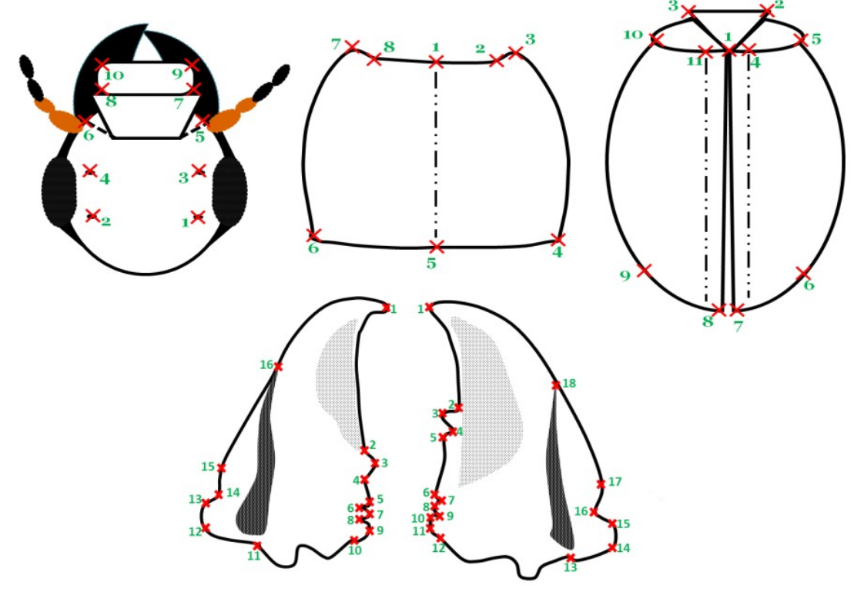
Objective of the thesis
How to automatically predict the coordinates of the landmarks?
Notes:
4
Along with each image, a set of landmarks have been given manually by the biologist. For example, head has 10 landmarks, pronotum has 8 landmarks.
My objectives are provides the methods to automatically provide the coordinates of the landmarks

Slide 5
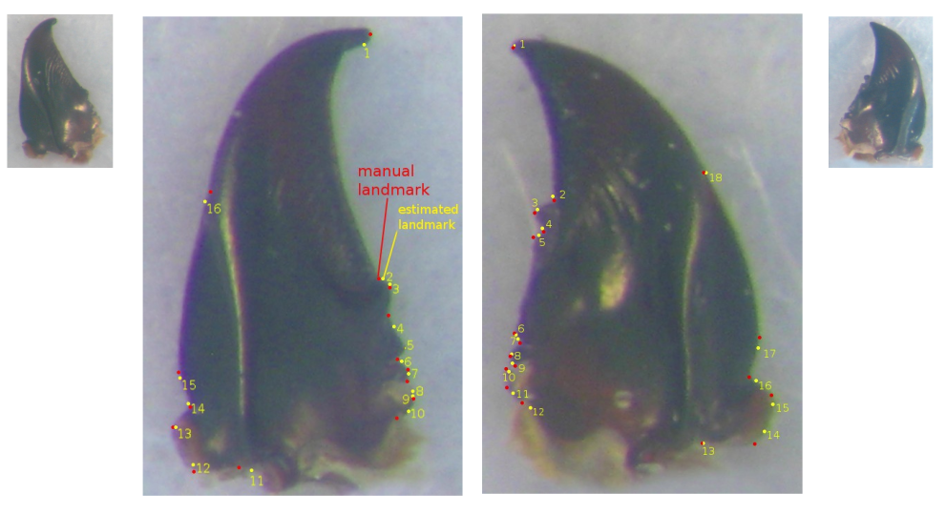
Progress of the thesis: the 1st year
Notes:
5
In the first year, we have studied left and right mandibles which have been seen as easy to apply image processing for landmarking.
In order to estimate landmarks, we have used an Iterative of Principal Component Analysis to register two images before indicating the landmarks.

Slide 6
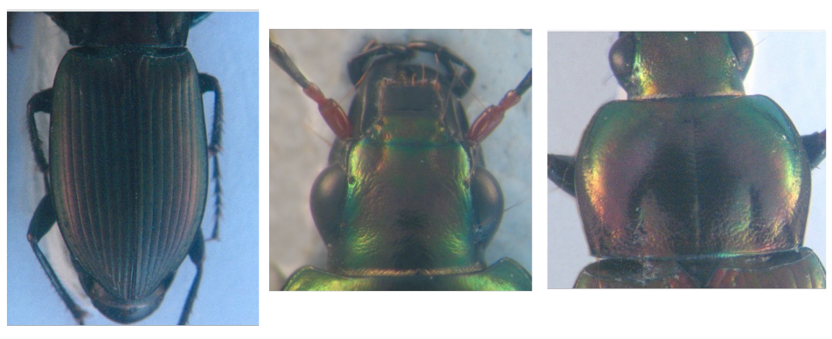
Progress of the thesis: the 2nd year
➔ Applying Deep Learning
Notes:
6
In the second year, we have continued our work on other parts of the beetles.
A difference between the mandibles and these part is the images are noise.
We have tried PCAI method but it was not success. So, we have decided to use Deep Learning method

Slide 7
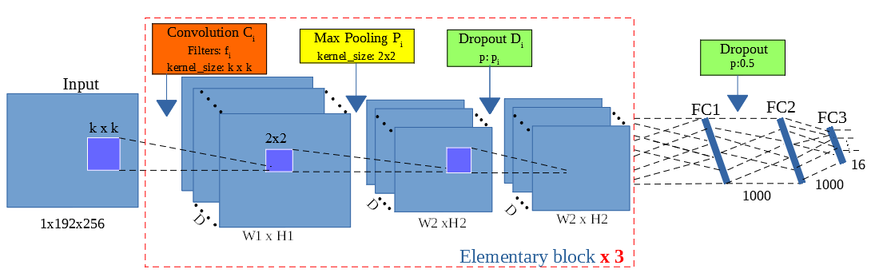
Network architecture
Notes:
7
We have proposed a network including the combination of several types of layers.
For training process, the network receives an images and its manual landmarks.
After training, it was used to predict the landmarks on the test images.

Slide 8
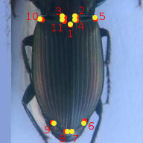
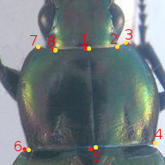
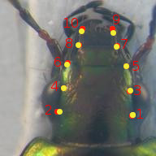
Results in the 2nd year
Notes:
8
Red points are manual landmarks
Yellow points are predicted landmarks.

Slide 9
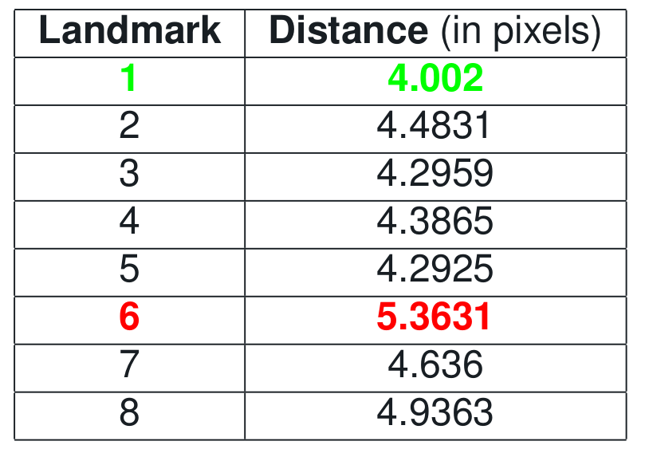
Results in the 2nd year
Notes:
9
We have also calculated the average distance on each landmark.

Slide 10
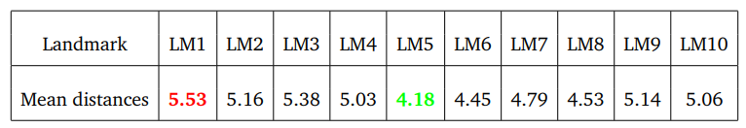
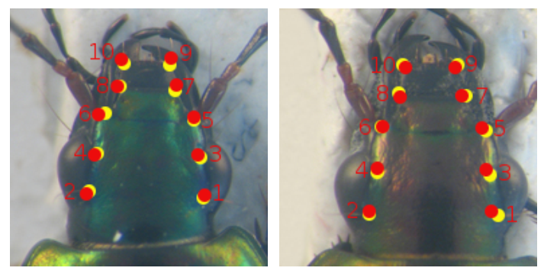
Results in the 2nd year
Notes:
10

Slide 11
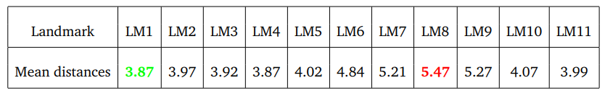
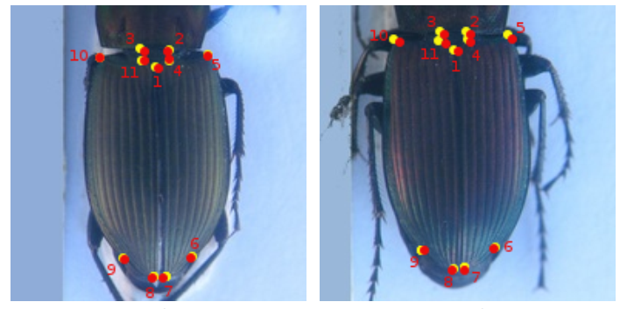
Results in the 2nd year
Notes:
11

Slide 12
The 3rd year
Continue the works to improve the results
Finish the required training lectures (100 hours)
Notes:
12

Slide 13
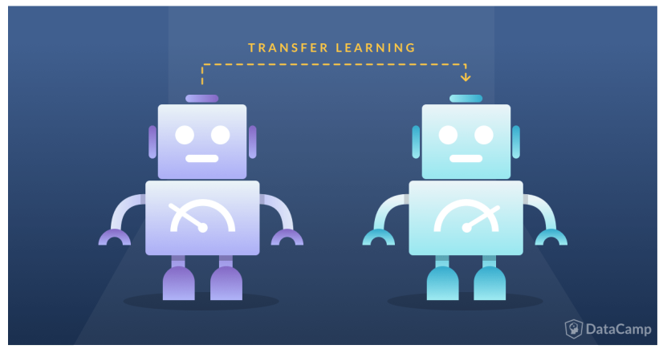
Improving the results
Notes:
13

Slide 14
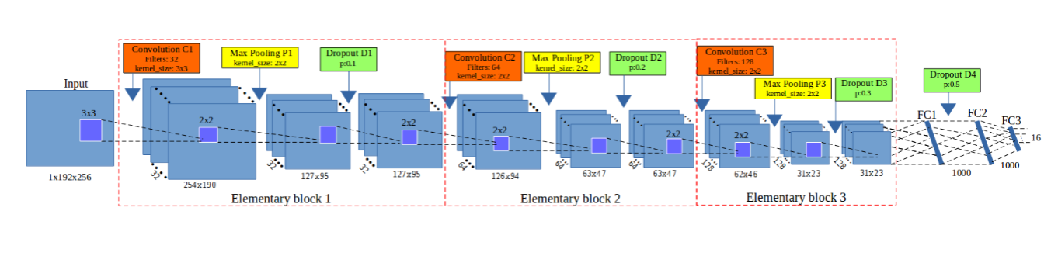
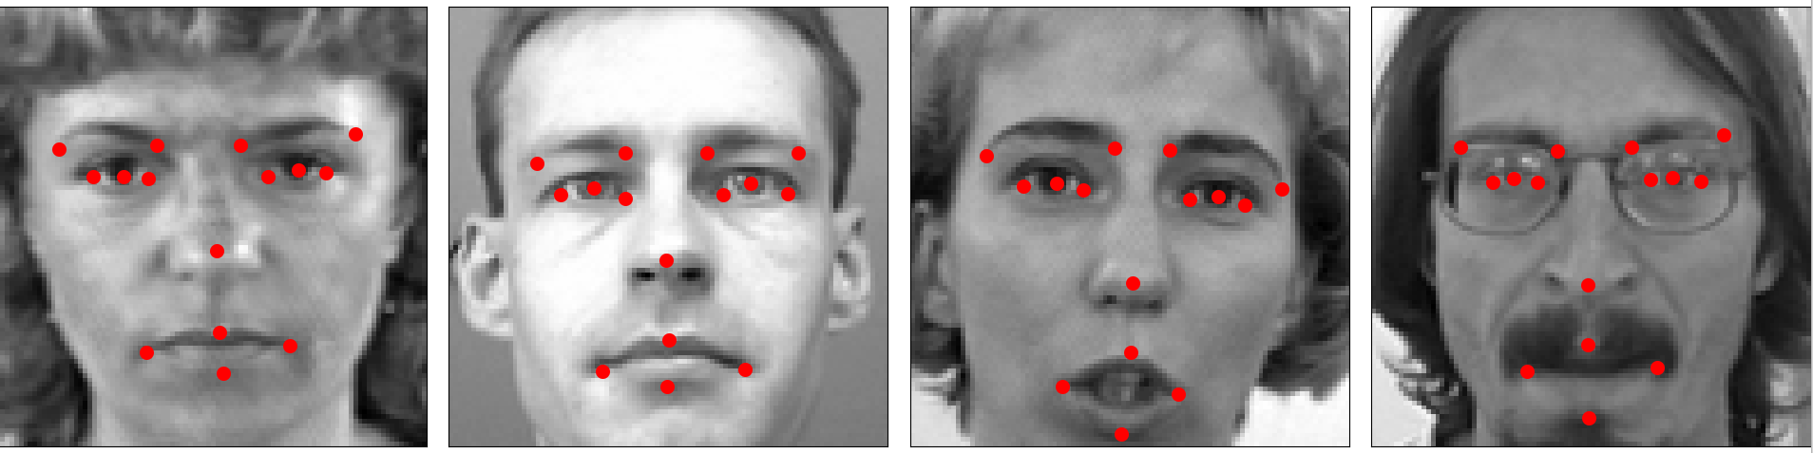
Improving the results
Continue to use the proposed model
Pre-train the model on a facial key points dataset.
Then, transfer the parameter values to fine-tune on our images.
Notes:
14

Slide 15
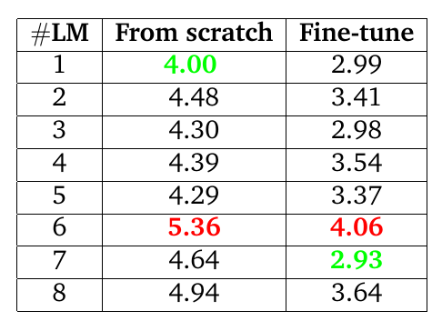
Improving the results
The average distance of each landmark on all pronotum images
Notes:
15

Slide 16
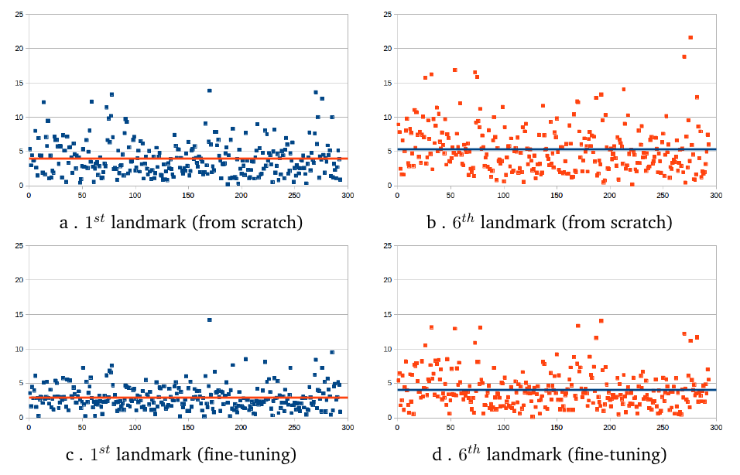
Improving the results
The distribution of the distances
Notes:
16

Slide 17
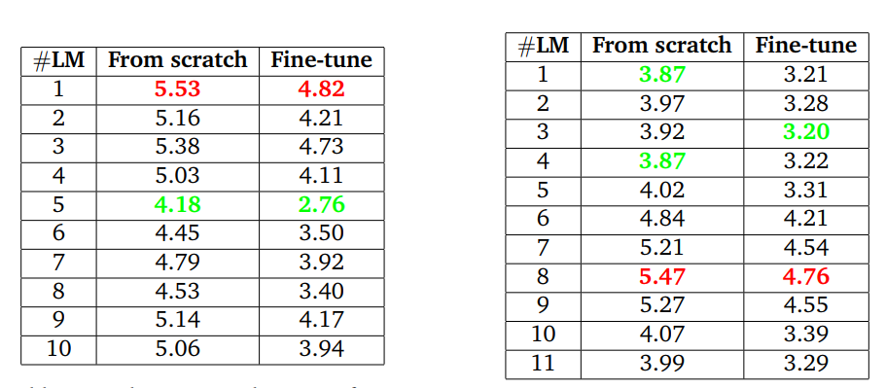
Improving the results
The average distances on head and elytra
Notes:
17

Slide 18
I have done
Research:
Submit the paper to a Journal (under reviewing).
Tried to fine-tune other architectures, but the results were not improved.
Turned to Reinforcement learning to automatically design architecture, but it was still not succeed.
Academic works:
Taught several lectures at university
Applied for a teaching position.
Notes:
18

Slide 19
Teaching lectures
5CEF6T0M - TD Gestion des données
5CEG4TFM - TD Systèmes d'information de gestion
TD - Programmation Orientée Objet
Deep learning (Master Bio-Informatique)
Co-supervise: Project programming, Internship
Notes:
19

Slide 20
Training courses attended
Francais Langue Étrangère (40 heures)
Anglais niveau intermédiaire (25 heures)
Notes:
20

Slide 21
Thank you
Notes:
21

